Slide 1
PHP for Server-Side
Preprocessing
Chapter 8

Slide 2
Overview and Objectives (1 of 2)
Present a brief history of the PHP language as a reasonable choice for server-side processing
Discuss how PHP fits into the overall web picture as a scripting language
Discuss several features of the PHP language, as required for our purposes (while comparing and contrasting with JavaScript):
  comments, variables (including superglobals), numerical and string data types, expressions and operators, arrays, built-in and programmer defined functions, file output, and server-side inclusion of files
Incorporate into our home page a PHP-generated welcome message, including the current date and time
Discuss how to make the date and time of our home page welcome message keep up-to-date

Slide 3
Overview and Objectives (2 of 2)
Provide a brief introduction to AJAX, show how it is helpful with our welcome message and show how to use it for the refresh
Introduce PHP sesssions
Discuss the GET and POST “methods”
Implement the server-side functionality of our feedback form:
  sending the user’s feedback to the business via email, sending a copy of the e-mail to the client, storing a copy of the feedback on the server
Implement an alternate version of our BMI calculator, using server-side
PHP instead of client-side JavaScript, which allows us to email the user a permanent record
Show how to send HTML-encoded email, as we do when delivering our BMI report
Use the POST value of the method attribute of the form element to submit form data
Discuss PHP script development and testing

Slide 4
PHP History
PHP stood for Personal Home Page, when originally implemented by Rasmus Lerdorf in 1995 for tracking accesses to his online resume.
A revised version was called PHP/FI, where FI stood for Forms Interpreter.
Now users prefer to use the recursive name PHP: Hypertext Preprocessor.
Perl was the language of choice for server-side computing prior to PHP.
Constructs of PHP: Origins in Perl and similar to JavaScript.
Source code for PHP was made public and that led to a vibrant community of developers.

Slide 5
Some PHP Milestones
Date | Version | Notes
1994 | Original (private) | Rasmus Lerdorf writes first incarnation of PHP for personal use and calls it “Personal Home Page Tools”
June, 1995 | 1.0 | Lerdorf releases source code to the public
November, 1997 | 2.0 | Now called PHP/FI2 (FI = “Forms Interpreter”), and contained many features that are still part of PHP
June, 1998 | 3.0 | Development has moved from one person to a team
May, 2000 | 4.0 | Based on a new parser called the Zend Engine
July, 2004 | 5.0 | Based on the new Zend Engine II
August, 2014 | 5.6 | Many improvedments over 5.0
N/A | 6.0 | This version, which was supposed to incorporate core Unicode support, was eventually abandoned
November, 2015 | 7.0 | Based on Zend Engine III, with many more improvements

Slide 6
PHP as a Server-Side
Scripting Language
Most web servers support a PHP interpreter.
A web developer may not automatically have access to PHP on a server provided by an ISP.
PHP has to be activated and configured for use with the help of system administrator.
A web server may spawn a separate operating system processes to handle PHP requests, or it may be “built-into” the server: This will be “transparent to the user”.
PHP-related pages cannot be viewed properly simply by loading them into your browser on your PC.
Instead, PHP-related pages will need to be uploaded to a PHP-enabled web server and “served” by that web server in order to function properly.

Slide 7
Just a Few PHPLanguage Facts
PHP is case-sensitive.
In PHP all variable names start with a $.
PHP variables are dynamically typed (the type is determined by the current value of the variable).
PHP functions are much like JavaScript functions, and variables declared in a function are local to the function by default.
PHP uses // and /* … */ for comments.
PHP generally uses the echo statement for output.
PHP uses curly brackets, if … else, switch, for, while and do … while as you might expect, and also has a foreach loop for processing an entire array.
PHP has the usual operators and, like JavaScript, both == and ===.

Slide 8
But … a Few PHPLanguage Gotchas
Altlhough PHP variable names are case-sensitive, function names and keywords are not.
PHP also uses # for single-line comments.
PHP has Integer, Double, String (single or double quotes) and Boolean primitive types.
Inside double quotes a variable is replaced by its value (this is called variable interpolation).
PHP arrays can be viewed either as “ordinary” arrays with integer indexes, or as a list of key/value pairs.
PHP uses the dot operator (.) to concatenate strings, not the + operator.
"

Slide 9
Experimenting with PHP
If you have an account on a server where PHP is available, log in and enter the following command in a command window:
$ php –a
This should give you a PHP prompt where you can enter PHP statements and experiment with the language.
Example:
php > echo "Hello world!\n";
Hello, world!

Slide 10
PHP: A Simple Example welcome.php
<!DOCTYPE html>
<!-- welcome.php -->
<html lang="en">
<head>
<meta charset="utf-8">
<title>Welcome Message with Date and Time</title>
</head>
<body>
<h2>Welcome!</h2>
<?php
echo "<h3>It's ".date("l, F jS").".<br>\r\n";
echo "The time is ".date("g:ia").".</h3>\r\n";
echo "<h3>Or at least that's our time, though ".
"it may not be yours.</h3>\r\n";
?>
<h6>Pedagogical Note:<br>This page is static,
and therefore will not change once displayed.</h6>
</body>
</html>

Slide 11
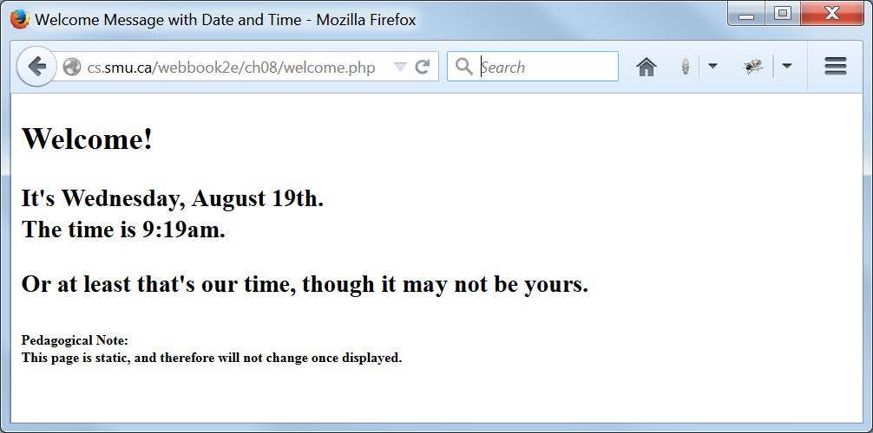
A Browser Display of welcome.php

Slide 12
Diving Right In:
What do we see in welcome.php?
A PHP script between the PHP “delimiters”: <?php … ?>
Two PHP echo statements that send strings containing markup to the web page (note that statements end with a semicolon).
The use of the PHP built-in function date() to return a date value for inclusion in the web page.
  date("l, F jS") returns the current date as a string, with the day in long (l) form, the full (F) name of the month, the date of the month in the Julian calendar (j), with the appropriate suffix (S) appended (the comma and two spaces are just literal characters)
  date("g:ia") actually returns a time, rather than a date, again as a string, with g giving the hour in 12-hour format with no leading zeros, i giving the minutes with leading zeros, and a causing am or pm to be appended, as appropriate (the colon is a literal character)
The (somewhat unorthodox) use of the period (.) as the string concatenation operator in PHP. Can you spot which periods are used like this, and which are just periods at the ends of sentences?

Slide 13
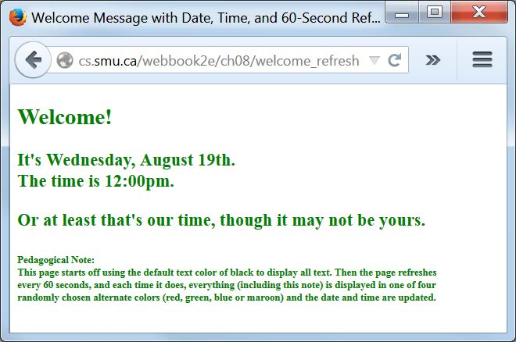
A Browser Display of welcome_refresh.php

Slide 14
The Markup (1 of 2) for welcome_refresh.php
<?php
/*welcome_refresh.php
This page displays a welcome message and the complete page
is refreshed every 60 seconds. Initially the text color is
black, but each refresh uses a randomly chosen text color
from red, green, blue or maroon. Because the color choice
is random, the same color may repeat after a refresh.
*/
session_start();
if (!isset($_SESSION['pageRefreshCount']))
$_SESSION['pageRefreshCount']=0;
?>
<!DOCTYPE html>
<html lang="en">
<head>
<meta charset="utf-8">
<meta http-equiv="refresh" content="60">
<title>Welcome Message with Date, Time, and 60-Second Refresh</title>
</head>
<body id="welcome">
<h2>Welcome!</h2>

Slide 15
The Markup (2 of 2) for welcome_refresh.php
<?php
$greetingColor = "black";
if ($_SESSION['pageRefreshCount'] != 0)
{
$colorPicker = rand(1, 100);
if ($colorPicker > 75)
$greetingColor = "red";
else if ($colorPicker > 50)
$greetingColor = "green";
else if ($colorPicker > 25)
$greetingColor = "blue";
else
$greetingColor = "maroon";
}
$_SESSION['pageRefreshCount'] = $_SESSION['pageRefreshCount'] + 1;
echo "<p hidden id='colorChoice'>$greetingColor</p>";
echo "<h3>It's ".date("l, F jS").".<br>\r\n";
echo "The time is ".date("g:ia").".</h3>\r\n";
echo "<h3>Or at least that's our time, ".
"though it may not be yours.</h3>\r\n";
?>
<h6>Pedagogical Note:<br>This page ... </h6>
<script>
var hiddenParagraph = document.getElementById("colorChoice")
document.getElementById("welcome").style.color=
hiddenParagraph.innerHTML;
</script>
</body>
</html>

Slide 16
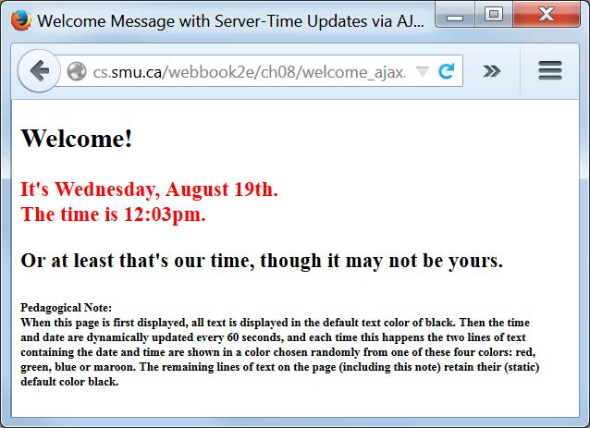
A Browser Display of welcome_ajax.php

Slide 17
The Markup (1 of 3) for welcome_ajax.php
<?php
/*welcome_ajax.php
This page displays a welcome message in which the date and
time are refreshed every 60 seconds via AJAX communication
with the server. Initially the text color of the entire page
is black, but each refresh uses a randomly chosen text color
from red, green, blue or maroon just for the two lines containing
the date and time information. Because the color choice is
random, the same color may repeat after a refresh. The rest
of the page is not refreshed, so its text color remains black.
*/
session_start();
if (!isset($_SESSION['timedateRefreshCount']))
$_SESSION['timedateRefreshCount'] = 0;
?>
<!DOCTYPE html>
<html lang="en">
<head>
<meta charset="utf-8">
<title>Welcome Message with Server-Time Updates via AJAX</title>

Slide 18
The Markup (2 of 3) for welcome_ajax.php
<script>
//This script sets up the AJAX infrastructure for requesting
//date, time and random display color updates from the server.
var request = null;
function getCurrentTime()
{
request = new XMLHttpRequest();
var url = "time.php";
request.open("GET", url, true);
request.onreadystatechange = updatePage;
request.send(null);
}
function updatePage()
{
if (request.readyState == 4)
{
var dateDisplay = document.getElementById("datetime");
dateDisplay.innerHTML = request.responseText;
var hiddenParagraph = document.getElementById("colorChoice");
dateDisplay.style.color = hiddenParagraph.innerHTML;
}
}
</script>
</head>

Slide 19
The Markup (3 of 3) for welcome_ajax.php
<body id="welcome">
<h2>Welcome!</h2>
<?php
echo "<h3 id='datetime'>It's ".date("l, F jS").".<br>\r\n";
echo "The time is ".date("g:ia").".</h3>\r\n";
?>
<h3>Or at least that's our time, though it may not be yours.</h3>
<h6>Pedagogical Note:<br>When this page ... </h6>
<script>
getCurrentTime();
setInterval('getCurrentTime()', 60000)
</script>
</body>
</html>

Slide 20
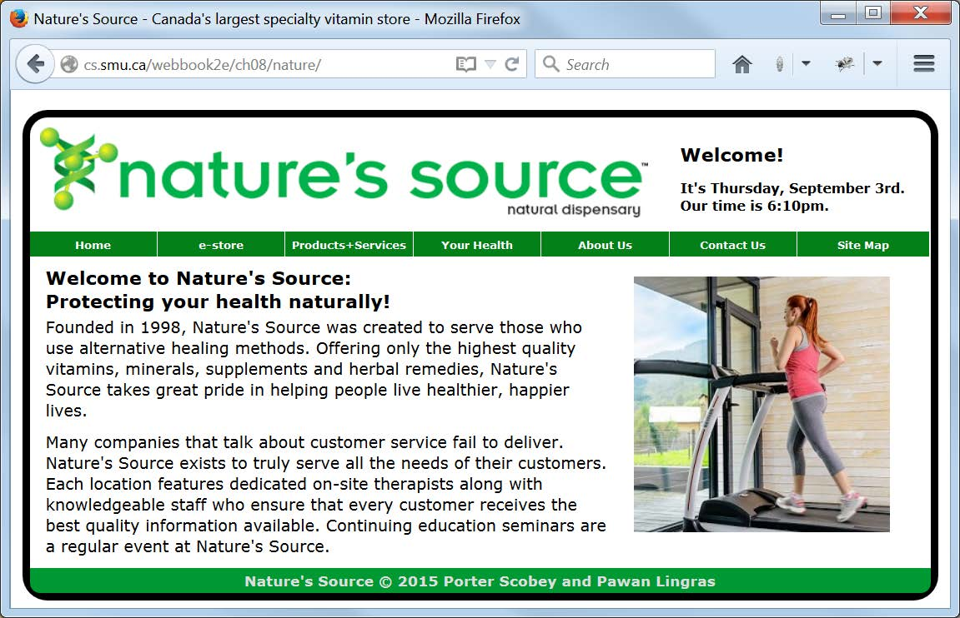
A Browser Display of index.php: Now Contains
A Welcome Message, with Date and Time from the PHP Script Output

Slide 21
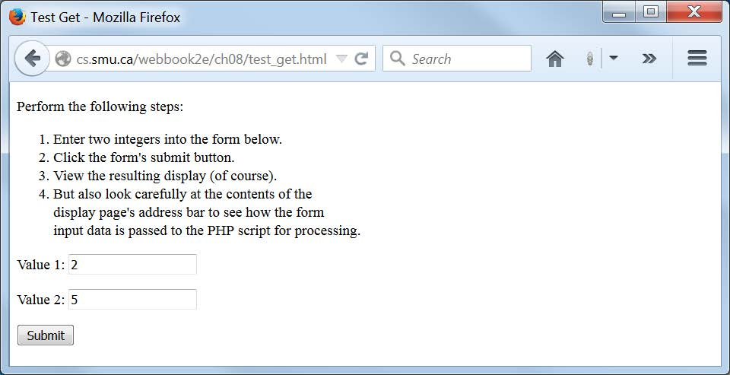
A Browser Display of test_get.html

Slide 22
The test_get.html File
<!DOCTYPE html>
<!-- test_get.html -->
<html lang="en">
<head>
<meta charset="utf-8">
<title>Test Get</title>
</head>
<body>
<p>Perform the following steps:<p>
<ol>
<li>Enter two integers into the form below.</li>
<li>Click the form's submit button.</li>
<li>View the resulting display (of course).</li>
<li>But also look carefully at the contents of the
<br>display page's address bar to see how the form
<br>input data is passed to the PHP script for processing.</li>
</ol>
<form method="get" action="test_get.php">
<p>Value 1: <input type="text" name="value1"></p>
<p>Value 2: <input type="text" name="value2"></p>
<p><input type="submit" name="submit" value="Submit"></p>
</form>
</body>
</html>

Slide 23
The test_get.php File (Part 1 of 2)
<!DOCTYPE html>
<!-- test_get.php -->
<html lang="en">
<head>
<meta charset="utf-8">
<title>A PHP Script for Testing the GET Protocol</title>
</head>
<body>
<?php
echo "<h2>You sent me the values $_GET[value1] and $_GET[value2].
<br>Here is their product: ";
echo $_GET['value1'] * $_GET['value2'];
echo "</h2>";
//Note in the above code that within the double quoted string
//there are no single quotes surrounding value1 or value2, but
//outside double quotes value1 and value2 are surrounded by
//single quotes. There are other ways to structure this code
//while achieving the same output, but this is probably the
//simplest and least likely to cause hard-to-find bugs.

Slide 24
The test_get.php File (Part 2 of 2)
$value = 7;
displayValues($value); //Note: function call (this line)
//can precede function definition:
function displayValues($val)
{
echo "<h3>From the function displayValues(), \$val=$val.";
echo "<br>From the function displayValues(), \$value=$value.</h3>";
echo "<h4>You need to know why the value 7 appears in the
<br>first of the two statements immediately above,<br>
but not in the second. Can you explain this?<br>Hint:
<br>Look at the PHP code to see what this little<br>
example tells you about PHP variable scope.</h4>";
}
?>
</body>
</html>

Slide 25
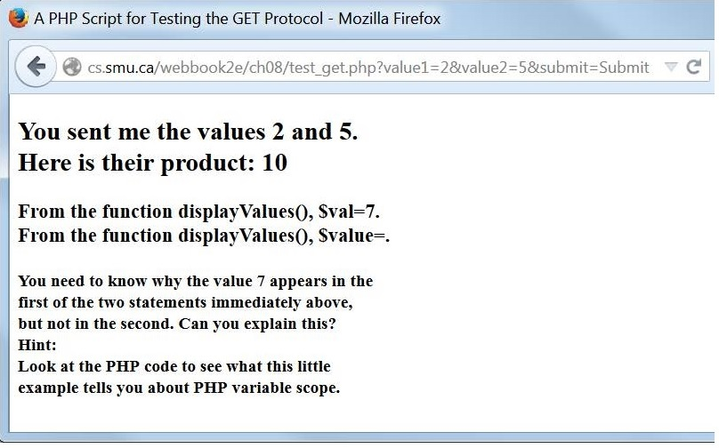
A Typical Result of Processing the Data from test_get.html with test_get.php
Look at the URL and find the values that were submitted from the form (2 and 5)

Slide 26
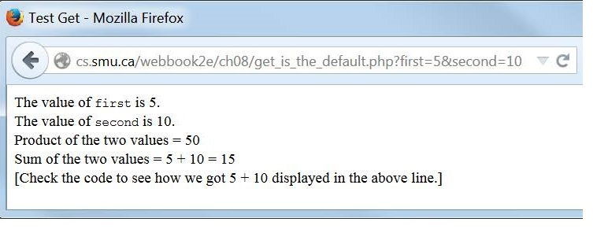
A Typical Result of Running get_is_the_default.php

Slide 27
What about POST?
To use the POST method for form data submission we change method="get" to method="post".
From a high-level view we can say that POST works the same as GET but the data sent by POST is sent “behind the scenes” and is not visible in the URL or anywhere else.
Both GET and POST (as method attribute values) are case-insensitive.
On the server side values sent by GET are available in the superglobal array $_GET and those sent by POST are available in the superglobal array $_POST.

Slide 28
GET vs. POST Usage Guidelines
Use POST if you are transferring a lot of data.
Use POST if you don’t want the user to see what you’re sending.
Use POST if your data is going to change something at the destination (database content, for example).
Use GET if you’re just getting some information from the destination (from a database on a server, for example)
Use GET for short communications between scripts on the server.
Definitely use GET if you’re sending small amounts of data, you don’t care who sees it, and you don’t want to bother setting up a form to receive and transmit the data.

Slide 29
Our New Index File: index.php (1 of 2)
<?php include("common/document_head.html"); ?>
<!-- index.php for ch08/nature -->
<body onload="startRotation()">
<header>
<?php
include("common/banner.php");
include("common/menus.html");
?>
</header>
<main>
<article id="textLeft">
<h3>Welcome to Nature's Source:<br>
Protecting your health naturally!</h3>
<p>Founded in 1998, Nature's Source was created ... </p>
<p>Many companies that talk about customer service ... </p>
</article>

Slide 30
Our new index file: index.php (2 of 2)
<div id="image">
<img id="placeholder" src=""
alt="Healthy Lifestyle"
width="256" height="256">
</div>
</main>
<footer>
<?php include("common/footer_content.html"); ?>
</footer>
</body>
</html>

Slide 31
Markup (Part 1 of 2) from Our New banner.php:
Extends the previous logo.html
<!-- banner.php -->
<div id="logo">
<img src="images/naturelogo.gif"
alt="Nature's Source"
width="608"
height="90">
</div>
<div id="welcome">
<h3>Welcome!</h3>
<h5 id="datetime"><?php
echo "It's ".date("l, F jS").".<br>";
echo "Our time is ".date('g:ia').".";
?></h5>
</div>

Slide 32
Markup (Part 2 of 2) from Our New banner.php:
Extends the previous logo.html
<script>
//This script sets up the AJAX infrastructure for
//requesting time updates from the server.
var request = null;
function getCurrentTime()
{
request = new XMLHttpRequest();
var url = "common/time.php";
request.open("GET", url, true);
request.onreadystatechange = updatePage;
request.send(null);
}
function updatePage()
{
if (request.readyState == 4)
{
var dateDisplay = document.getElementById("datetime");
dateDisplay.innerHTML = request.responseText;
}
}
getCurrentTime();
setInterval('getCurrentTime()', 60000)
</script>

Slide 33
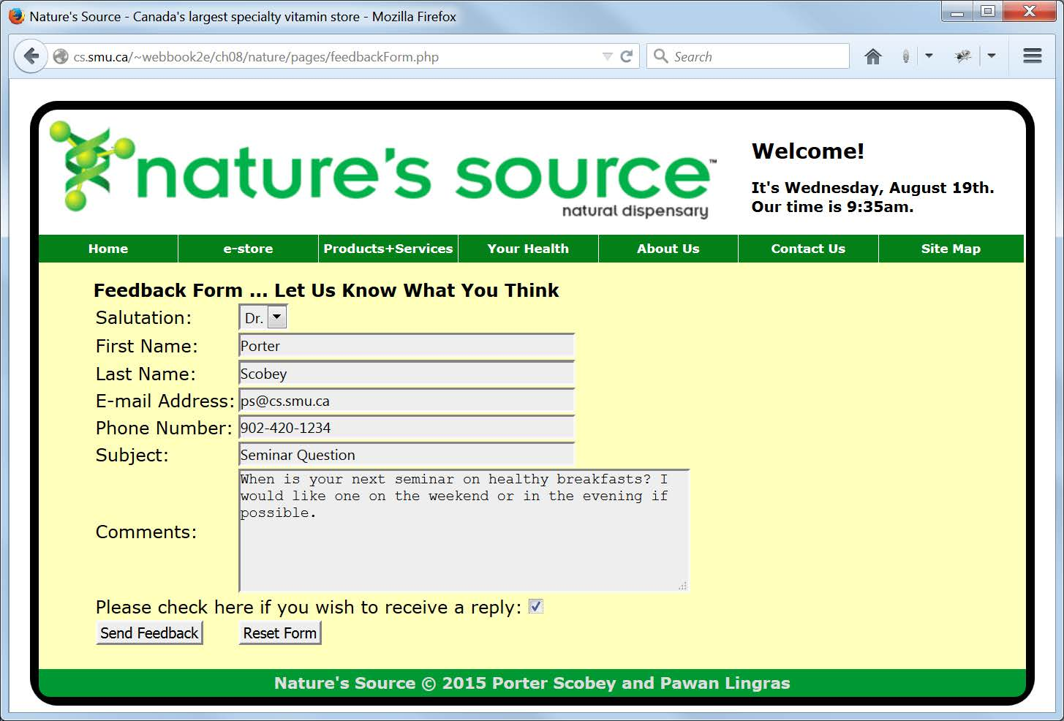
A Firefox browser display of feedbackForm.php

Slide 34
The Revised form Tag in feedbackForm.html
Invokes a Server-Side PHP Script for Processing When the Input Data is Valid
<form id="contactForm"
action="scripts/feedbackFormProcess.php"
method="post">

Slide 35
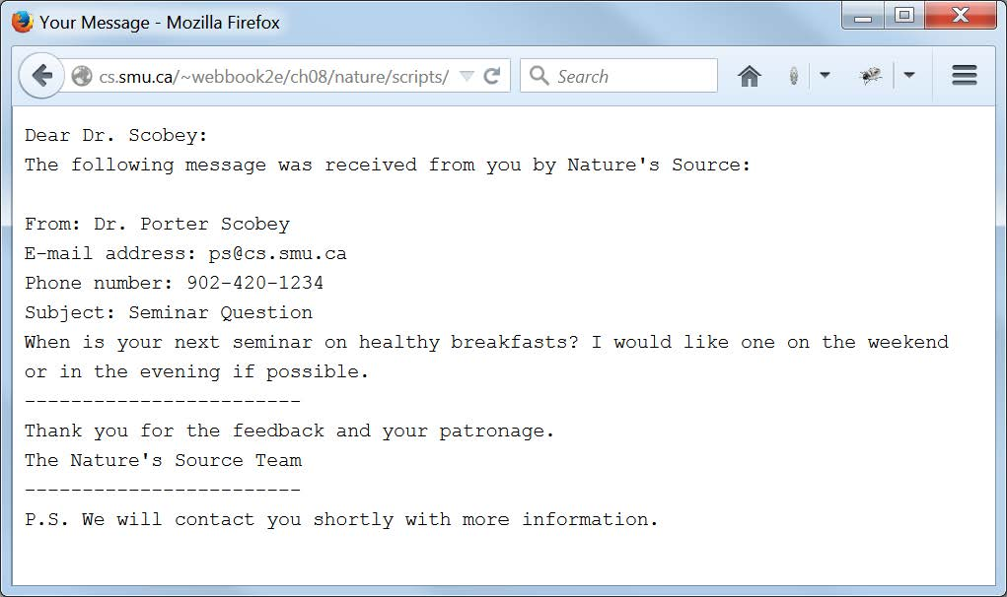
A Browser Display of Processing from feedbackFormProcess.php Showing Confirmation to the User That the Feedback Form Input Has in Fact Been Received

Slide 36
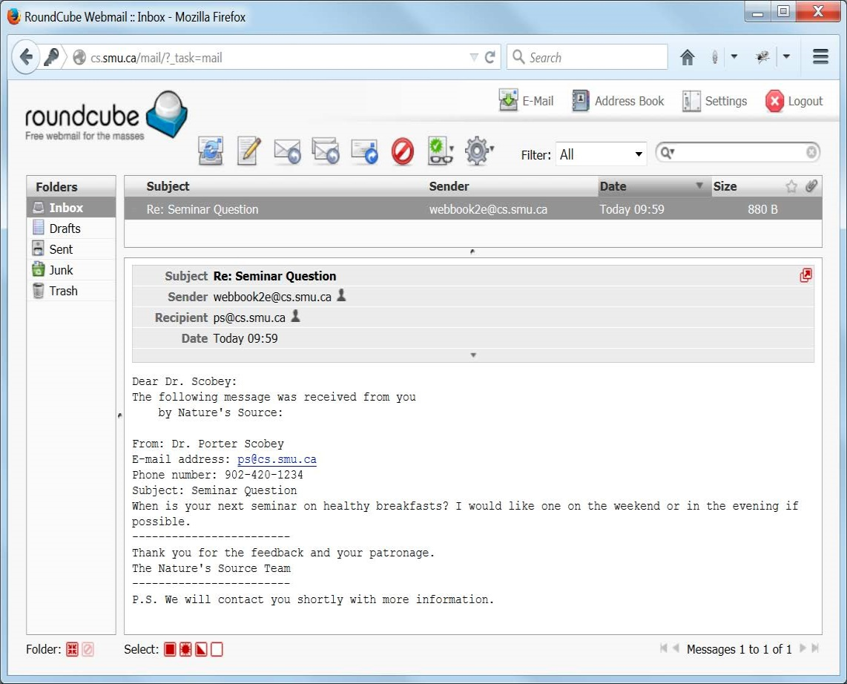
An Email Display Showing the Email Received by the Client as a Result of the Form Being Processed by feedbackFormProcess.php

Slide 37
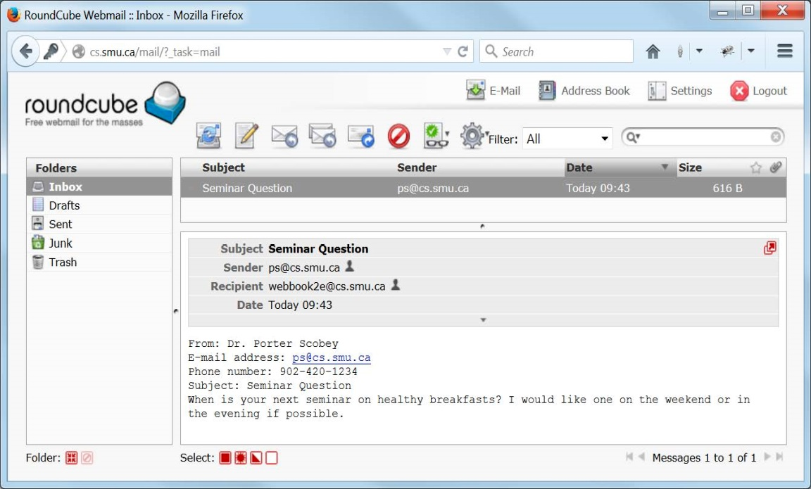
An Email Display Showing the Email Received by the Business as a Result of the Form Being Processed by processFeedback.php

Slide 38
A Typical Feedback Message, with Date of Submission,
As It Is Stored on the Server in a Log File Called feedback.txt in the Subdirectory nature/data
-------------------------------------------------------
Date received: 19th of August, 2015 at 09:43:55
From: Dr. Porter Scobey
E-mail address: ps@cs.smu.ca
Phone number: 902-420-1234
Subject: Seminar Question
When is your next seminar on healthy breakfasts?
I would like one on the weekend or in the evening
if possible.

Slide 39
PHP Code to Process Feedback in feedbackFormProcess.php (1 of 4)
<?php
/*feedbackFormProcess.php
Processes feedback form data by first constructing a
message of response from the user's input, and then
- sends an e-mail message to the business
- sends a sligtly modified e-mail message to the client
- returns a confirmation message to the client's browser
- logs the feedback in a file on the server
*/
//Construct message to be sent to the business
$messageToBusiness =
"From: $_POST[salute] $_POST[firstName] $_POST[lastName]\r\n".
"E-mail address: $_POST[email]\r\n".
"Phone number: $_POST[phone]\r\n".
"Subject: $_POST[subject]\r\n".
"$_POST[message]\r\n";

Slide 40
PHP Code to Process Feedback in feedbackFormProcess.php (2 of 4)
//Send e-mail feedback message to the business
//(but here, to the text's website)
$headerToBusiness = "From: $_POST[email]\r\n";
mail("webbook2e@cs.smu.ca", $_POST['subject'],
$messageToBusiness, $headerToBusiness);
//Construct e-mail confirmation message for the client,
//which is just a sligtly modified version of the message
//that went to the business
$messageToClient =
"Dear $_POST[salute] $_POST[lastName]:\r\n".
"The following message was received from you
by Nature's Source:\r\n\r\n".
$messageToBusiness.
"------------------------\r\n".
"Thank you for the feedback and your patronage.\r\n".
"The Nature's Source Team\r\n".
"------------------------\r\n";
if ($_POST['reply']) $messageToClient.=
"P.S. We will contact you shortly with more information.";

Slide 41
PHP Code to Process Feedback in feedbackFormProcess.php (3 of 4)
//Sends e-mail confirmation message to the client
$headerToClient = "From: webbook2e@cs.smu.ca\r\n";
mail($_POST['email'], "Re: $_POST[subject]",
$messageToClient, $headerToClient);
//Transforms confirmation message to HTML 5 format for
//display in the client's browser
$display = str_replace("\r\n", "\r\n<br>", $messageToClient);
$display = "<!DOCTYPE html>
<html lang='en'>
<head><meta charset='utf-8'><title>Your Message</title></head>
<body><code>$display</code></body>
</html>";
echo $display;

Slide 42
PHP Code to Process Feedback in feedbackFormProcess.php (4 of 4)
//Logs the message in data/feedback.txt on the web server
//Note: directory "data" is at same level as directory "scripts"
$fileVar = fopen("../data/feedback.txt", "a")
or die("Error: Could not open the log file.");
fwrite($fileVar,
"\n-------------------------------------------------------\n")
or die("Error: Could not write divider to the log file.");
fwrite($fileVar, "Date received: ".date("jS \of F, Y \a\\t H:i:s\n"))
or die("Error: Could not write date to the log file.");
fwrite($fileVar, $messageToBusiness)
or die("Error: Could not write message to the log file.");
?>

Slide 43
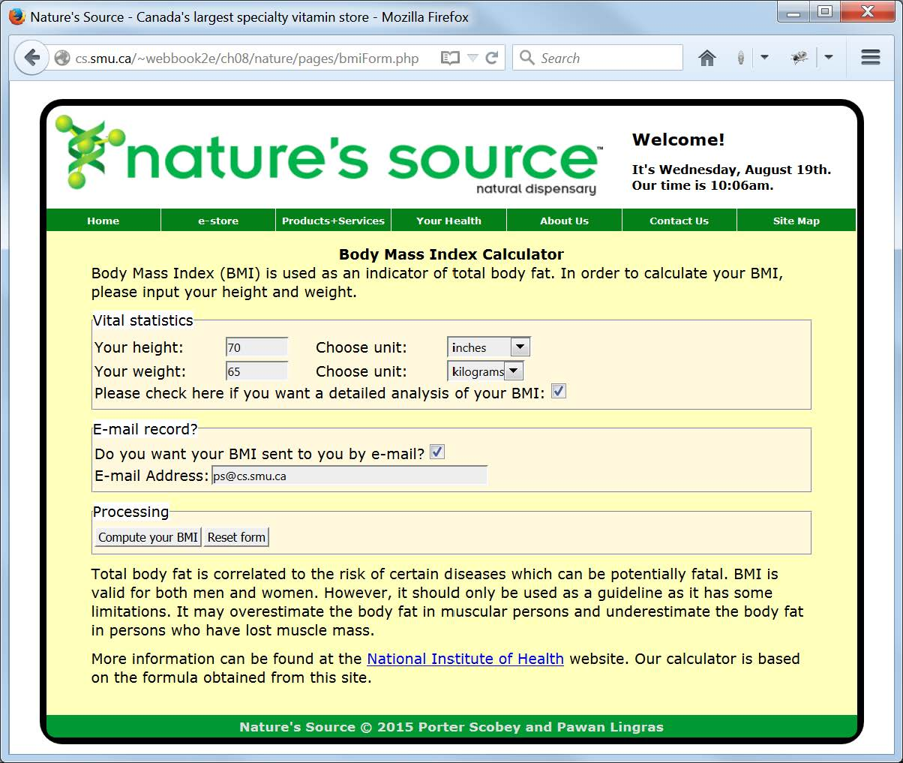
A browser display of bmiForm.php

Slide 44
The Revised form Tag Which Invokesa PHP Script for Processing the Form Data from bmiForm.php
<form id="bmiForm"
onsubmit="return bmiFormValidate()"
action="scripts/bmiFormProcess.php"
method="post">

Slide 45
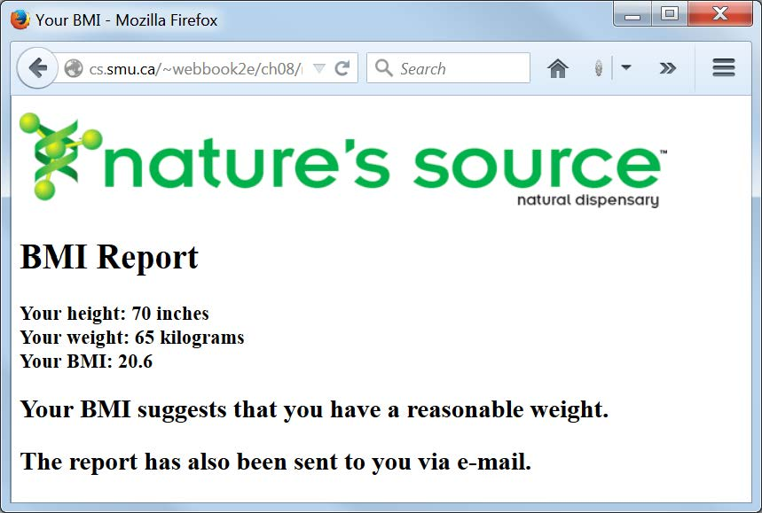
A browser Display of Processing from bmiFormProcess.php

Slide 46
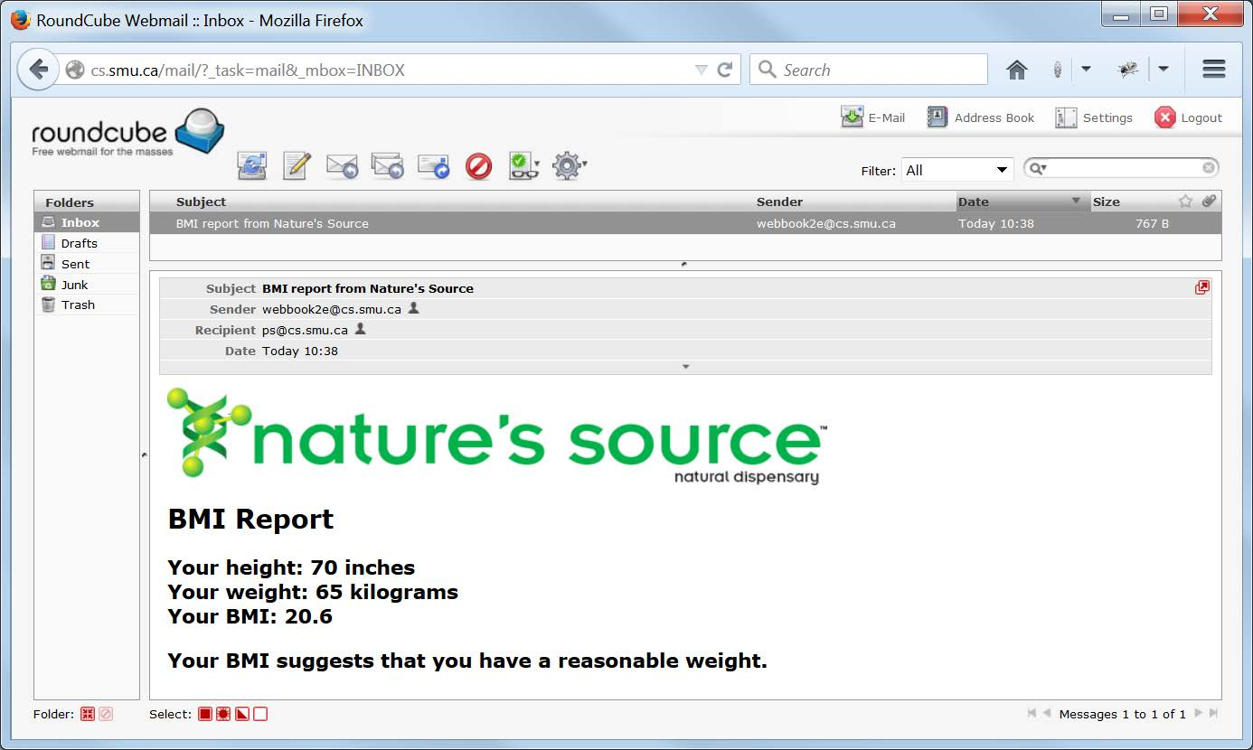
E-mail Received by the Client As a Result of Processing from bmiFormProcessBMI.php

Slide 47
PHP Code to Process BMI in bmiFormProcess.php
<!DOCTYPE html>
<!-- bmiFormProcess.php
The driver script for the BMI calculation based on the
user data entered into the BMI form.
-->
<html lang="en">
<head>
<meta charset="utf-8">
<title>Your BMI</title>
</head>
<body>
<p>
<?php
include 'bmiCalculate.php';
if ($_POST['details'])
$message = detailedMessage($_POST['height'], $_POST['heightUnit'],
$_POST['weight'], $_POST['weightUnit']);
else
$message = simpleMessage($_POST['height'], $_POST['heightUnit'],
$_POST['weight'], $_POST['weightUnit']);
echo $message;
if ($_POST['wantMail'])
{
mailBMI($_POST['email'], $message);
echo "<h2>The report has also been sent to you via e-mail.</h2>";
}
?>
</p>
</body>
</html>

Slide 48
PHP Programmer-defined Functions (1 of 4)
<?php
/*bmiCalculate.php
Functions to perform the BMI value calculation,
to one place after the decimal, assuming all data
input by the user has been validated, and to assemble
the text including this value to be returned to the
browser for display to the user
*/
//Constructs and returns the simple form of the BMI message
function simpleMessage($height, $heightUnit, $weight, $weightUnit)
{
$bmi = sprintf("%1.2f", calculateBMI($height, $heightUnit,
$weight, $weightUnit));
$text = "<h1>BMI Report</h1><h3>Your BMI is $bmi.</h3>";
return $text;
}

Slide 49
PHP Programmer-defined Functions (2 of 4)
//Constructs and returns the detailed form of the BMI message
function detailedMessage($height, $heightUnit, $weight, $weightUnit)
{
$bmi = sprintf("%.1f", calculateBMI($height, $heightUnit,
$weight, $weightUnit));
$text = "<p><img src='http://cs.smu.ca/webbook2e/images/naturelogo.gif'
alt='Nature's Source Logo'></p>
<h1>BMI Report</h1>
<h3>Your height: $height $heightUnit<br>
Your weight: $weight $weightUnit<br>
Your BMI: $bmi</h3>";
if ($bmi < 18.5)
$text .= "<h2>Your BMI suggests that you
are underweight.</h2>";
else if ($bmi < 25)
$text .= "<h2>Your BMI suggests that you
have a reasonable weight.</h2>";
else if ($bmi < 29)
$text .= "<h2>Your BMI suggests that you
are overweight.</h2>";
else
$text .= "<h2>Your BMI suggests that you
may be obese.</h2>";
return $text;
}

Slide 50
PHP Programmer-defined Functions (3 of 4)
//Simple conversion functions
function inchesToCentimetres($height) { return $height*2.54; }
function poundsToKilograms($weight) { return $weight/2.2; }
//Computes and returns the BMI value. Note that it does not matter
//whether both units are metric or non-metric or mixed.
function calculateBMI($height, $heightUnit, $weight, $weightUnit)
{
if ($heightUnit == "inches") $height = inchesToCentimetres($height);
if ($weightUnit == "pounds") $weight = poundsToKilograms($weight);
$height /= 100.0; //Convert height from centimeters to meters
$bmi = $weight/($height*$height);
return $bmi;
}

Slide 51
PHP Programmer-defined Functions (4 of 4)
//Constructs and sends the e-mail message as HTML
function mailBMI($email, $message)
{
$header = "MIME-Version: 1.0\r\n";
$header .= "Content-type: text/html; charset=utf-8\r\n";
$header .= "From: webbook2e@cs.smu.ca\r\n";
mail($email, "BMI report from Nature's Source",
$message, $header);
}
?>

Slide 52
Notes on PHP Development and Testing
Create a simple PHP script containing an obvious error (missing semicolon, missing quote) to see if an error is reported when it runs (an ugly error message will be displayed in the browser if PHP is reporting errors).
If not, speak to your admin to have your PHP environment configured to report errors.
Now, during development, put the PHP function call error_reporting(E_ALL)
at the beginning of any script for which you wish to receive error reports.
When you are happy with the script, turn off error reporting for that script by changing the function call to error_reporting(0).

